Slide 1
CSE322
PROPERTIES OF REGULAR LANGUAGES
Lecture #12

Slide 2
Properties of
Regular Languages

Slide 3




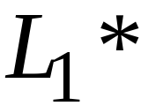
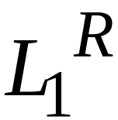


For regular languages and
we will prove that:
Union:
Concatenation:
Are regular
Languages
Star:
Reversal:
Complement:
Intersection:

Slide 4
We say: Regular languages are closed under
Union:
Concatenation:
Star:
Reversal:
Complement:
Intersection:

Slide 5
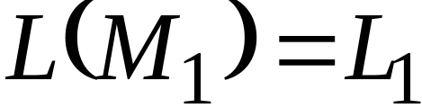
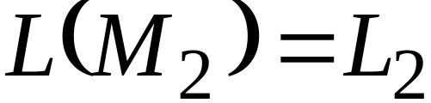


Regular language
Regular language
NFA
NFA
Single accepting state
Single aceepting state

Slide 6


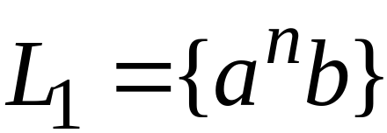

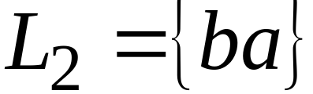
Example

Slide 7

Union
NFA for

Slide 8
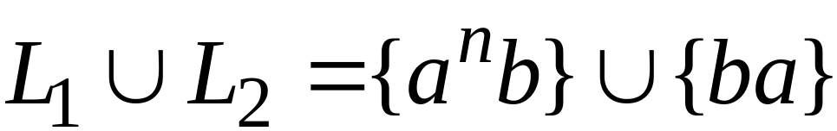
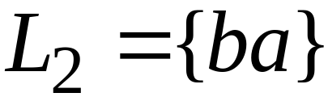
Example
NFA for

Slide 9
Concatenation
NFA for

Slide 10
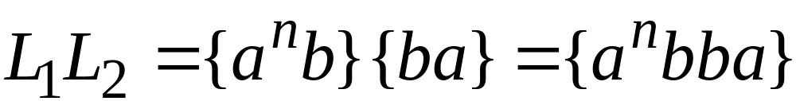
Example
NFA for

Slide 11
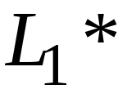
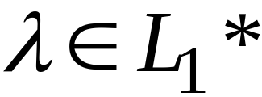
Star Operation
NFA for

Slide 12
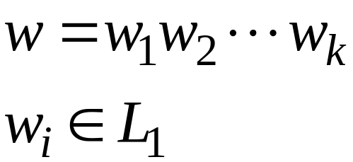
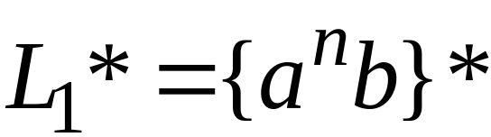
Example
NFA for

Slide 13

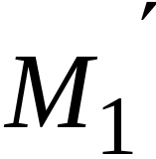
Reverse
NFA for
Homework 2

Slide 14
Complement
Homework 2

Slide 15
Intersection
regular
We show
regular
regular

Slide 16




DeMorgan’s Law:
regular
regular
regular
regular
regular

Slide 17
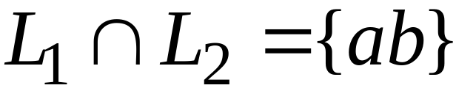
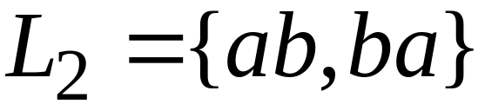
Example
regular
regular
regular

Slide 18

Another Proof for Intersection Closure
Machine
Machine
FA
for
FA
for
Construct a new FA that accepts
simulates in parallel and

Slide 19

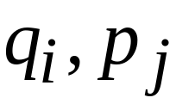
States in
State in
State in

Slide 20




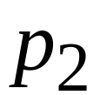
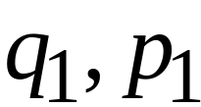
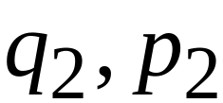
FA
FA
transition
transition
FA
transition

Slide 21

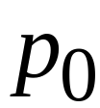
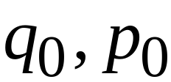
FA
FA
initial state
initial state
FA
Initial state

Slide 22



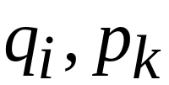
FA
FA
accept state
accept states
FA
accept states
Both constituents must be accepting states

Slide 23

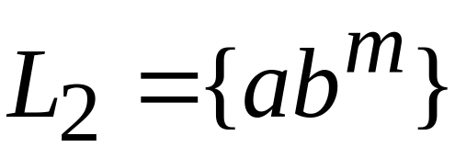








Example:

Slide 24
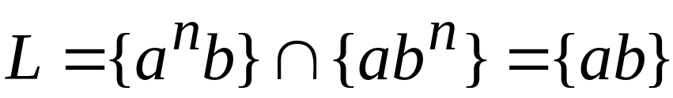







Automaton for intersection

Slide 25


simulates in parallel and
accepts string
if and only if
accepts string and
accepts string

